Slide 1

StraySpotter
Asa Dillahunty, Dylan Marcum-Pollard,
Lillian Presley, Sav Campbell

Slide 2
Project Focus
The focus of our project was to create an application that allowed the user to both upload pictures of stray animals that they find during their everyday lives and browse the pictures for sightings of their missing pets.
To do this, uploaded pictures needed to have their locations stored and we needed a way for those pictures to be found by the user. The idea was that if you knew where your animal was spotted, it could assist in finding your lost pet.

Slide 3
Sprint 1 Goals
Sprint 1 Main Goals:
Set up the Firestore Database and connect the project to Firebase
Research and work on connecting our geotagging feature
Initial UI created and create the first draft of the main “pet finder” screen in list view
Complete the project website
Additional Stretch Goals:
First draft of the user uploads screen implemented
Allow the user to update the geotag if they aren’t where they were when they took the picture
Assignments:
Dylan: Geotagging
Sav: Database
Lily: Website
Asa: UI

Slide 4
Major Sprint Achievements
The base UI was completed (including options for a dark and light theme)
The database was created and connected to the project.
Geotagged pins were successfully added to a map which can be viewed in app.
Project Website completed.

Slide 5
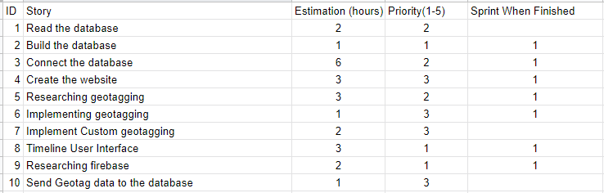
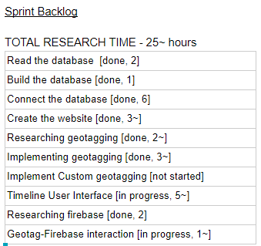
Project Backlog and Sprint Backlog

Slide 6
What Was Not Completed & Lessons Learned
User upload feature not implemented; locations are currently hard coded.
There is currently a test code which gets the user’s location and stores it, it just has not been implemented in the project… yet.
The database set up and connection took much longer than planned.
Learned a lot about Firebase and Gradle in the process
User Experience design is hard
Learned a lot about how CSS and animations are implemented in react native

Slide 7
Project Demo

